Slide 1
Deep Fakes and Fake News
Osmond Muromba
Takudzwa Muchada
Nyasha Shanganye

Slide 2
Fake news
Fake news is running rampant across all media outlets. While you may not take them seriously, these untrue news stories are playing with your emotions and have serious security implications.
Propaganda intends to manipulate public opinion about something, either by publishing misleading information or outright fabrication and lies. This has remained a matter of national security as those lies become used to intimidate and misinform voters, usually by those who do not have their best interests at heart, such as an enemy state.

Slide 3
How fake news spreads
These days, with technology and social media making for a much smaller world, it’s easy to share information across borders and sway anyone’s opinion on a matter.
With over half the world’s population online and using social media, news travels fast. And sometimes the wrong news gets spread.

Slide 4
Deep Fakes
Deepfakes can be defined as visual and audio content that has been manipulated using advanced software to change how a person, object or environment is presented.
Deepfakes have become synonymous with face replacement, where someone’s face is digitally mapped on to that of another person.
Face-swapping, as this type of deepfake is also known, was first used in the doctoring of pornographic videos

Slide 5
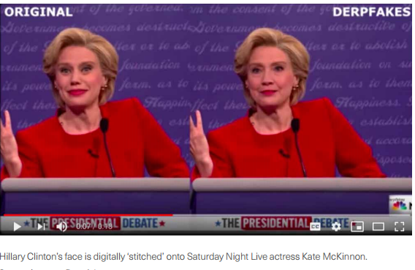
Face replacement
Otherwise known as face swapping, face replacement involves taking an image of someone’s face (the source) and carefully ‘stitching’ it onto that of another person (the target). The identity of the target is concealed, with the focus being on the source

Slide 6
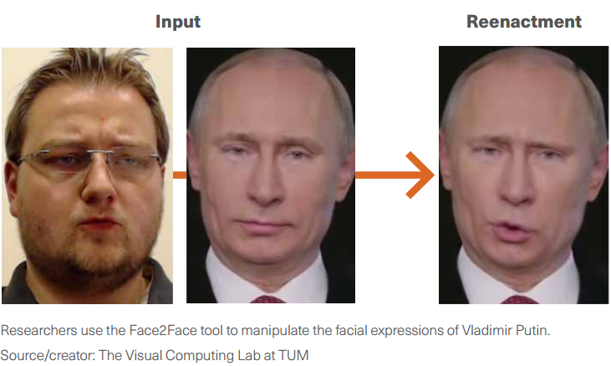
Face re-enactment
Also known as puppetry, face re-enactment entails manipulating the features of a target’s face, including the movement of their mouth, eyebrows, eyes and the tilting of their head. Re-enactment does not aim to replace identities but rather to contort a person’s expressions so they appear to be saying something they are not.

Slide 7
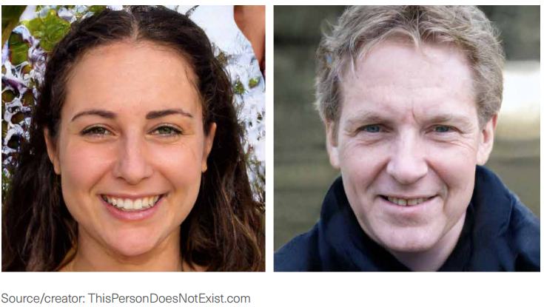
Face generation
Face generation involves creating entirely new images of faces. This is done using Generative Adversarial Networks, a novel form of deep learning that works by pitting two neural networks again stone another: the first to generate an image, and the second to judge whether that output is realistic

Slide 8
Speech synthesis
A relatively new branch of deep fakes, speech synthesis involves creating a model of someone’s voice, which can read out text in the same manner, intonation and cadence as the target person. Some speech synthesis products, such as Modulate.ai, allow users to choose a voice with any age and gender, rather than to emulate a specific target

Slide 9
How are Deep Fakes Created
Extraction- The first task is to collect sufficient images on which to train the face replacement model. A popular method is to start with videos of both the source and target persons, cut these into individual frames, and then crop the images so only a portrait of the face remains.
Training – The next task is to train the face replacement model using the images collected. This is done using an autoencoder, which is a neural network made up of two parts: an encoder and a decoder.9 The encoder takes an image of a face and compresses it into a low dimension representation, also known as the ‘latent face’. The decoder then takes that representation and reconstructs the face into its original form

Slide 10
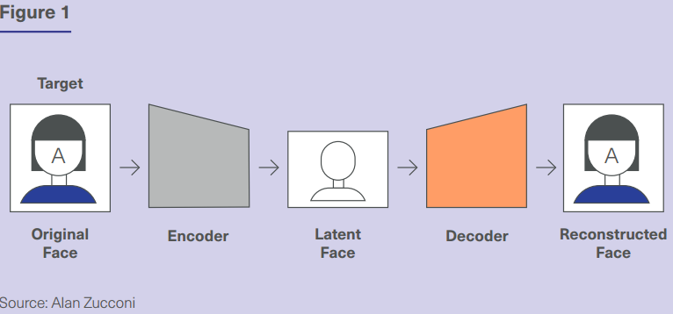
Training diagram

Slide 11
Face replacement
Face replacement is made possible by training two of these neural networks – one for the source face and one for the target face. Both networks share the same encoder, which means that the decompressed version of both faces shares a similar baseline architecture. However, they have different decoders (see Figure 2). Both neural networks are left to train until the autoencoding process can reconstruct an image of a face similar to its original version.

Slide 12
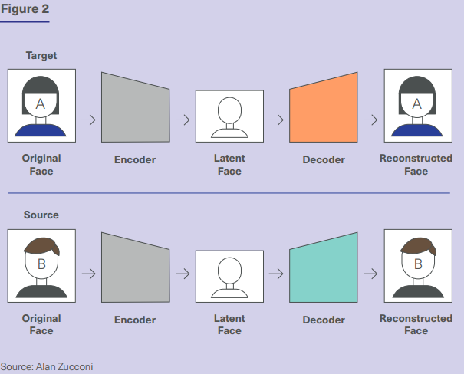
Face replacement diagram

Slide 13
Face replacement cont….
Once the training is complete, the decoders are then swapped, so that the source image is decompressed using its original encoder but reconstructed using the target image’s decoder.

Slide 14
Creation
Creation – The final task, and the most technically challenging, is to insert these deepfake images into the desired video. This means ensuring that, for every frame in the video, the angle of the synthesized face matches the angle of the head of the target person.

Slide 15
Are Deepfakes a Threat
Yes, and if so why?
1. Reduced Credebility
2. Reduced Authenticity
3. It used to stir up propaganda
4.

Slide 16
Are Deepfakes a Threat
NO, if so, then why?
1. with the current advancement in technology, reenacting old movies seen as public treasures is now a possibility, hence the phrase ‘Art never truly dies’
2. An example of this type of technology’s implementation would be the 2019 movie Gemini Man.
3. the goal of creating artificial voice replacements that people can adopt once they lose the ability to speak

